Slide 1
LISA TDI Testbed in Hannover

Slide 2
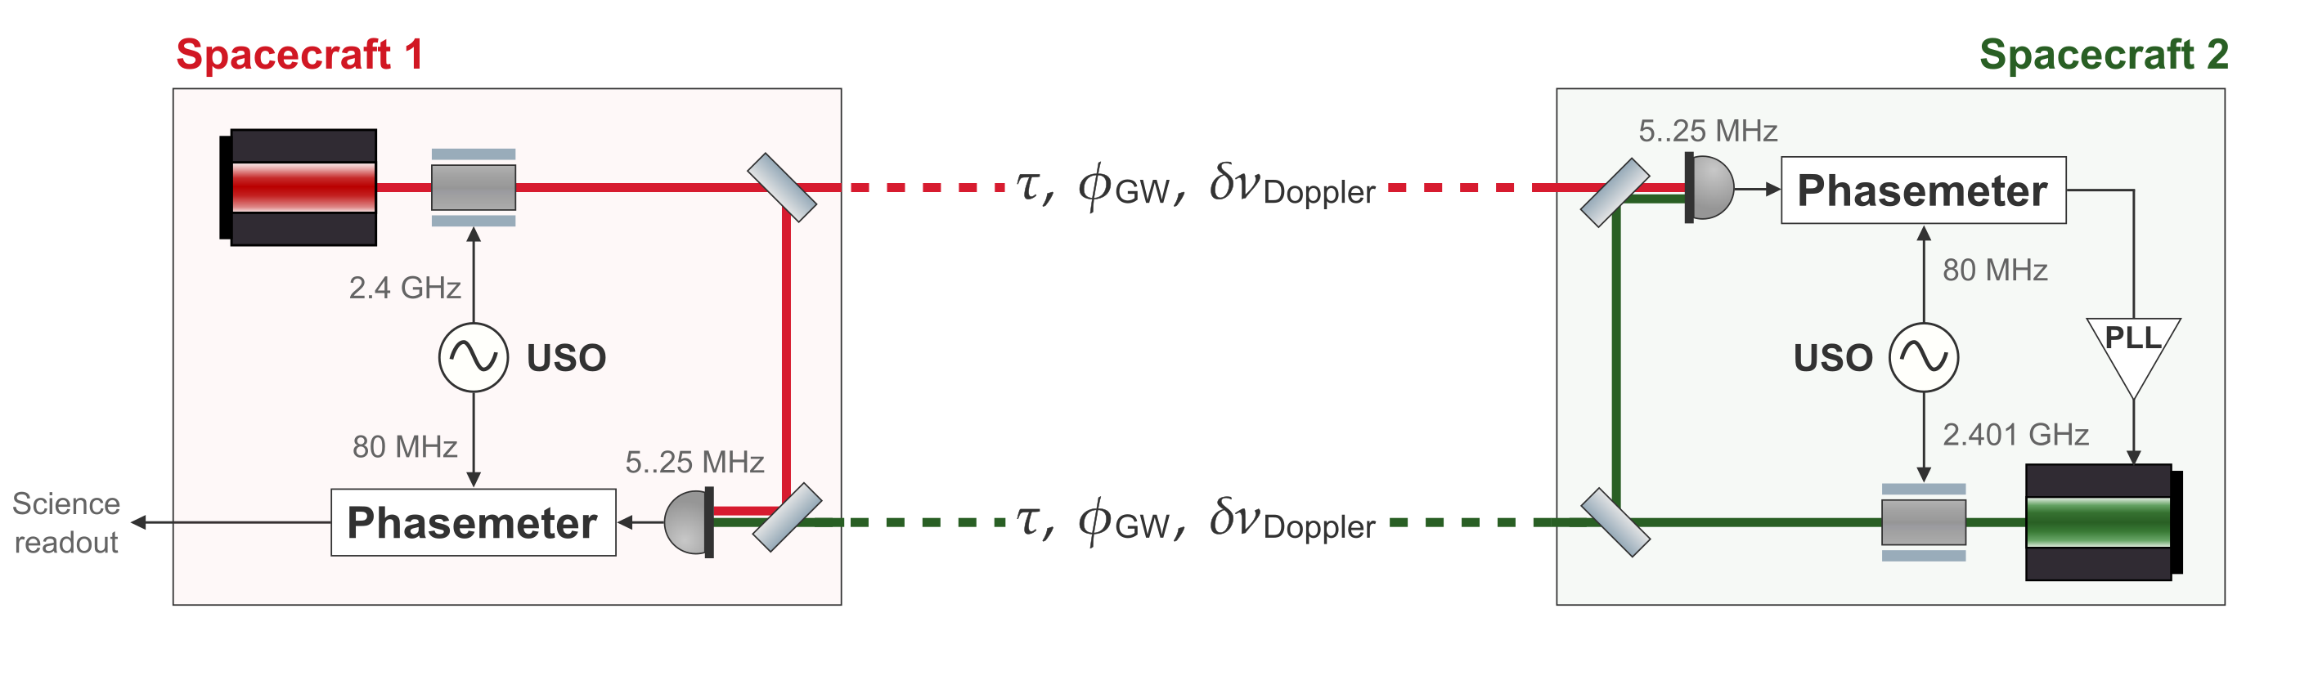
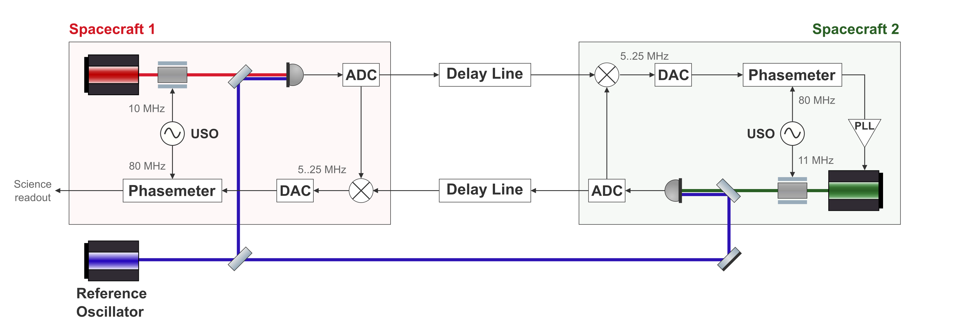
LISA vs Testbed arm link

Slide 3
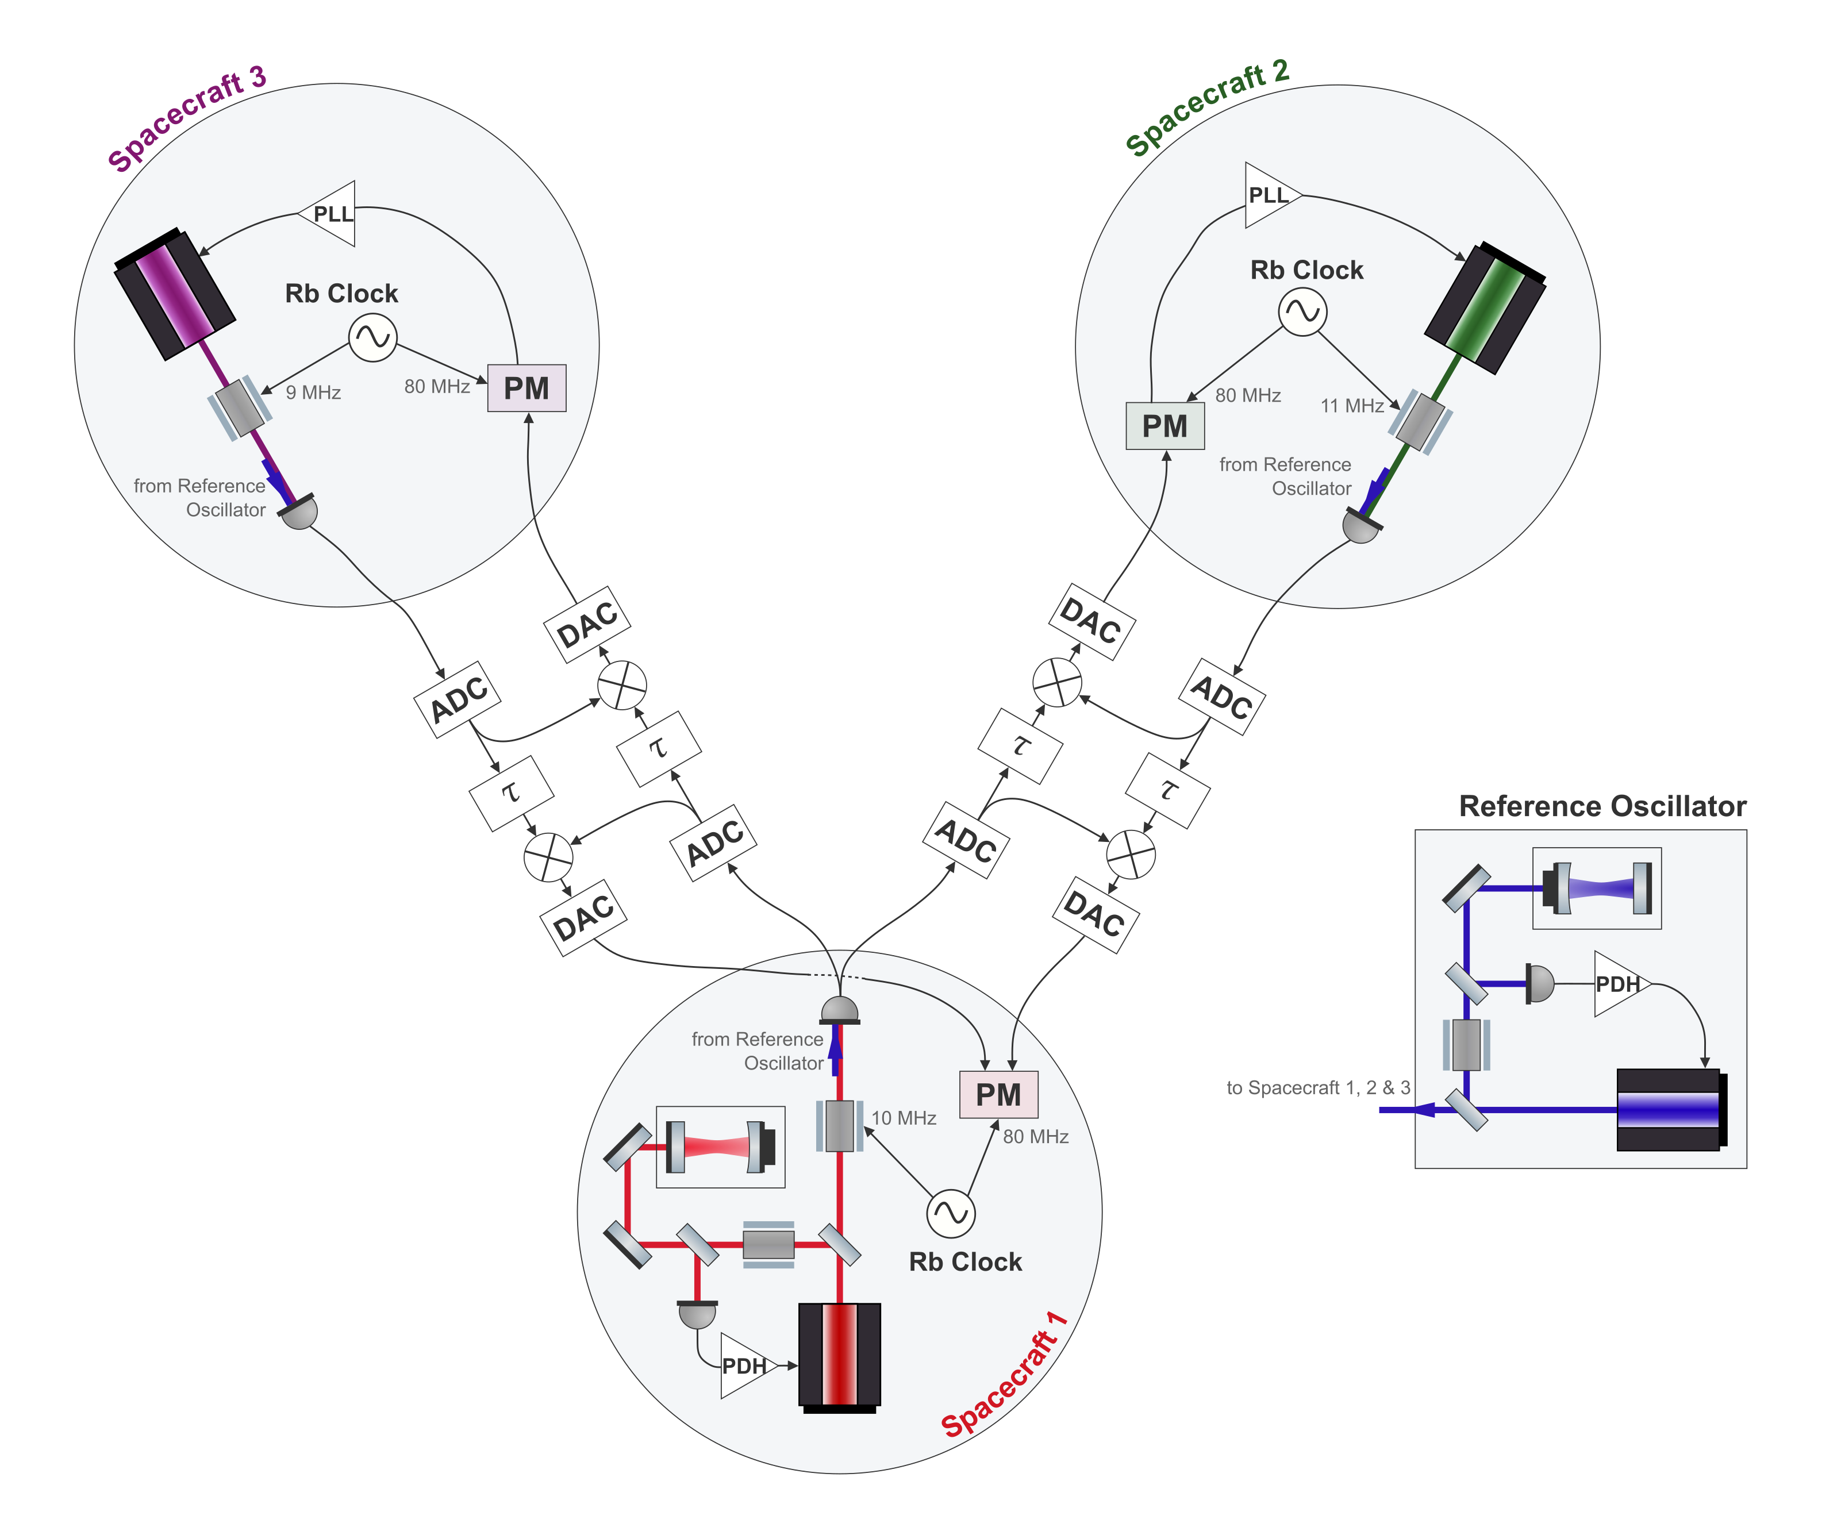
Michelson X Testbed

Slide 4
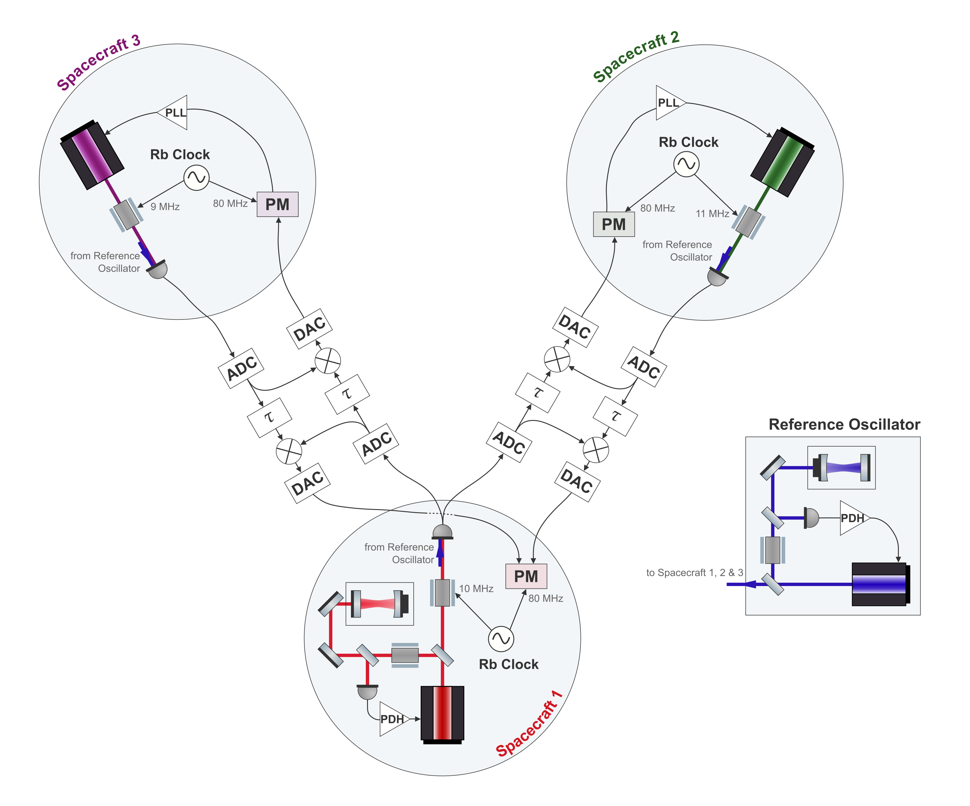
Transparent drawing

